Slide 1



AI PERSONAS
Enrico Chen - s337750
Van Thanh Nguyen - s336748
Xiaoning Ma - s337332

Slide 2
Project overview
OUR GOAL
Build an AI platform that enables internal business teams to interact with AI personas representing different market segments, in order to explore and test strategies.
Automatically organize unstructured data
Generate data-driven personas based on real market data
Deliver explainable answers with clear references
KEY FEATURES
Reduce time and resources spent on data preprocessing
Provide trustworthy and credible responses
Help teams make more focused and informed market strategies
BENEFITS

Slide 3

VALUE PROPOSITION
For business units struggling with evaluating marketing performances, customer understanding, models and ideas testing, our platform allows interacting with data-driven AI Personas representing the different market segments.

Slide 4
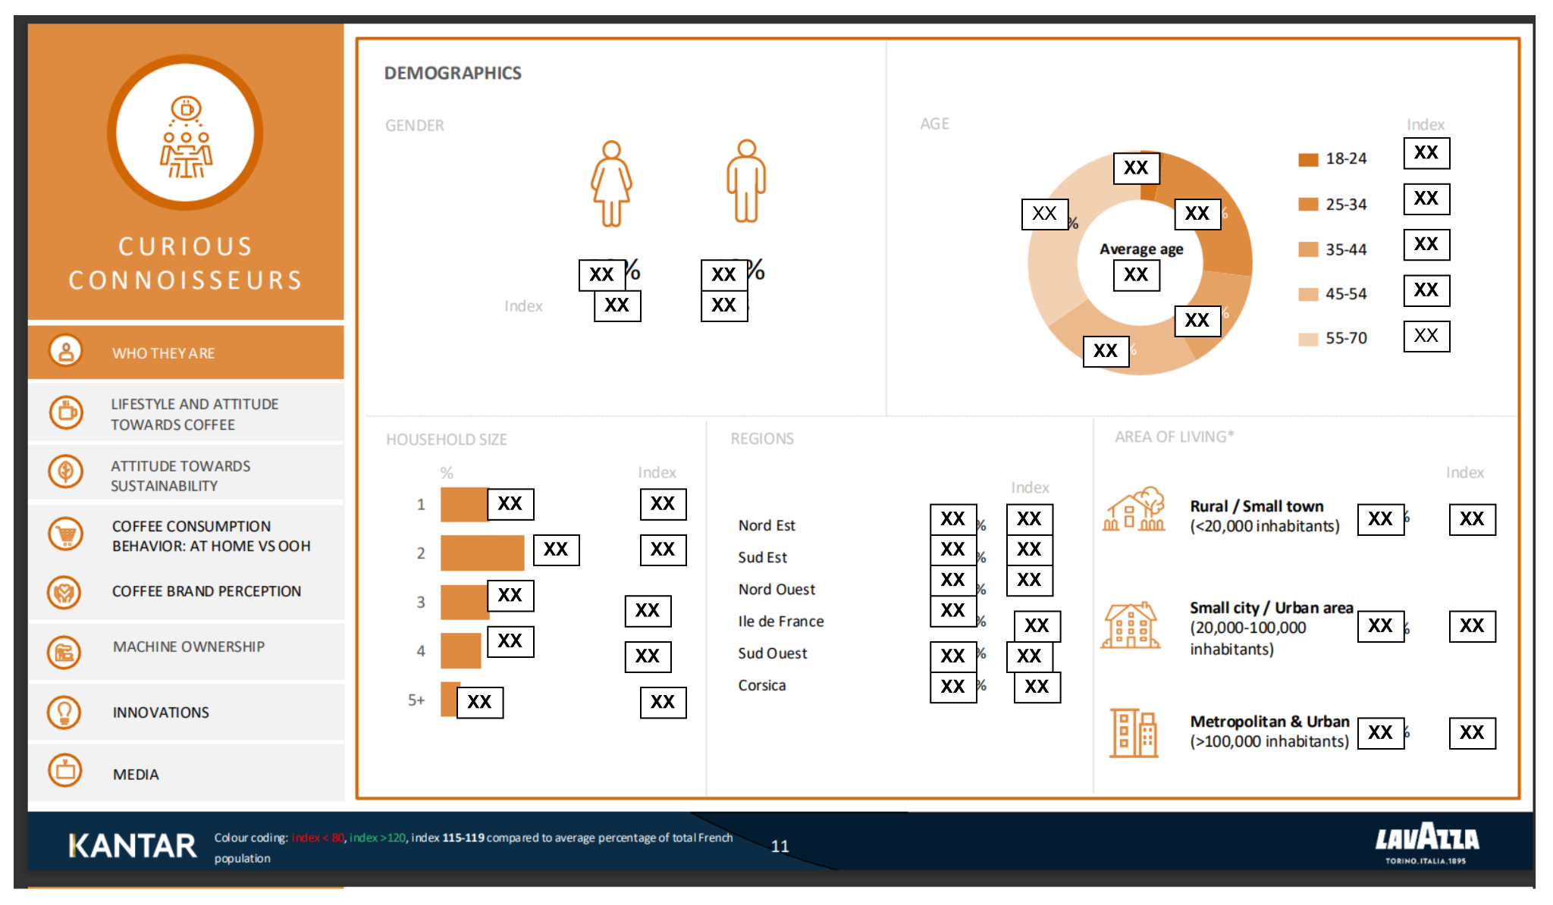
Research Questions
Extraction How can we automatically extract accurate data from complex, visually rich PDFs while preserving layout semantics?
Personality How can we infer latent reasoning traits (style profiles & value frames) from heterogeneous, noisy raw data to build consistent AI personas?
Grounding How can we reduce hallucinations in language model outputs while maintaining factual grounding?
For privacy and compliance reasons, certain details are omitted from this presentation.
Notes:
During conducting the project, we meet some very important questions: - Q1: extract data from visually rich pdf
- here is an exemple page of the raw data, it typically has multiple not only the charts but also may meaning full symbol, and layout
-Q2: how can we extract the persona traits from this raw data
- Q3: how can we prevent model from hallucications from provided data

Slide 5





Research Question 1
Question:
How can we automatically extract accurate data from complex, visually rich PDFs while preserving layout semantics?
Our solution:
We treat PDFs as visual documents and extract semantic meaning using a VLLM
Alternative Solutions:
Manual annotation: high accuracy, but low scalability, high costs
OCR-based pipelines: scalable, but limited layout information
PDF rendering
VLLM
Preserves layout and spatial relationships
Fully automated, no manual rules
Directly produces schema-consistent data ready for downstream use
Notes:
During conducting the project, we meet some very important questions: - Q1: extract data from visually rich pdf
- here is an exemple page of the raw data, it typically has multiple not only the charts but also may meaning full symbol, and layout
-Q2: how can we extract the persona traits from this raw data
- Q3: how can we prevent model from hallucications from provided data

Slide 6

Research Question 2
Question:
How can we infer latent reasoning traits (style profiles & value frames) from heterogeneous, noisy raw data to build consistent AI personas?
Our solution:
We use a cooperative multi-agent system in which each agent specializes in a specific stage of reasoning and trait inference.
Alternative Solutions:
Human review and inference: high accuracy but slow, subjective, and not scalable
Single-model end-to-end inference：automated, but sensitive to noise and lacking trait consistency
Agent 1
Extract persona information from raw data
Agent 2
Reason over extracted evidence to infer latent persona traits and priorities
Scalable and repeatable across datasets
Reduces subjective human bias
Produces consistent persona traits at scale
Notes:
During conducting the project, we meet some very important questions: - Q1: extract data from visually rich pdf
- here is an exemple page of the raw data, it typically has multiple not only the charts but also may meaning full symbol, and layout
-Q2: how can we extract the persona traits from this raw data
- Q3: how can we prevent model from hallucications from provided data

Slide 7

Research Question 3
Question:
How can we reduce hallucinations in language model outputs while maintaining factual grounding?
Our solution:
We integrate a RAG system that retrieves relevant evidence before generation and constraints model outputs to the retrieved context.
Alternative Solutions:
Prompt-based: lightweight, but unreliable and sensitive to prompt design
Pure fine-tuning: improves fluency, but does not guarantee factual grounding, computationally expensive
Orchestrator
Integrate retrieved information into the generation context
RAG
Retrieve relevant facts and indicators from the vector database
Improves factual accuracy and reduces hallucinations
Produces explainable, evidence-grounded responses
Maintains low computational costs
Notes:
During conducting the project, we meet some very important questions: - Q1: extract data from visually rich pdf
- here is an exemple page of the raw data, it typically has multiple not only the charts but also may meaning full symbol, and layout
-Q2: how can we extract the persona traits from this raw data
- Q3: how can we prevent model from hallucications from provided data

Slide 8



Dataset
Source & Scale
Data Structure
Key Dimensions
Kantar France 2023
4,001 Respondents
9 consumer segments
Rich qualitative + quantitative data
Multi-modal composition
Inconsistent layouts across segments
Mixed granularity
No unified or machine-readable format
Demographics
Psychographics
Coffee attitudes
Consumption behaviours
Brand perception & sustainability attitudes

Slide 9



Functional Diagram
Memory
Query
Orchestrator
Prompt Builder
LLM
Response
Online Process
Data Ingestion
RAG
Fact and indicator extraction
Dataset
Persona Registry
Persona traits extraction
Fact data: raw data extracted from dataset (including indicators)
Persona traits data: characteristics of the customer segments (like tone, style, values, preferences)
Notes:
We will see how the components of the system interact eachother to handle the query of user in this functional diagram
User sent input possibly has images and pdf -> orchestrator are an agentic planner of the system : applied some design pattern such as CoT and ReAct to plainning the strategy to answer the query, decide which actions should be done: -> call the memory to retrieve the relevant history of the chat -> parsing extracting useful information from input -> call the RAG to retrieve relevant internal fact data -> call Model Context Protocol server to using some useful tools such as websearch, call external apis … -> contexts will be aggregated by orchestrator-> entire the reasoning process will be tracked by explanation services to allow explain the reasoning and the source of used data.
All relevant context will be sent to prompt construction and be enhanced by persona traits -> stick llm model with particular persona during the generation answer and avoid hallucination

Slide 10






Method - Persona Extraction
VLLM Extraction
VLLM Reasoning
Prompt tuning
Fine-tuned AI Personas
Each page of the dataset
JSON indicators
Persona Traits
Chunker and Embedding Model
Indicator: “Segment S does not buy plastic packed items”
Trait:
style_profile (how they speak) includes “innovative”
value_frame (what they prioritize) includes “sustainability”
reasoning_policies (decision rules) includes “sustainability concerns”
Database
Notes:
n the persona extractions pipeline, i will present like the follow of the diagram basically, from raw data -> parsing to get data of eachpage -> using vllm model to extract useful data from page -> transform it into more structure data called indicators, indicators are stagements and mectrics which related to persona of customer segmentation -> aggreage indicators of each persona and sent to llm model to resasoning generate the structure data discribe for the persona such as style, value, behavior, priorities, ... -> apply this structure data for prompt tuning to align pretrain model with a specific persona we assume that generation llm model trained on massive data which contains multiple different personas. prompt engineering applied here helps to activate the specific persona we want the model to stick with

Slide 11



Method - Fact Extraction
VLLM
Chunker
Embedding Model
Each page of the dataset
Markdown output
Chunked output
Database
Fact data:
raw data from the dataset
includes indicators
included for future inputs

Slide 12
Method - RAG
RAG
Database
Query
Information Retrieval
Context
Given the query and customer segment type:
Retrieve k chunks for indicators
Retrieve k chunks for fact data
Return the chunks to the orchestrator

Slide 13
Method - Memory and Persona Registry
Memory
It stores the past max_items interactions
It enables multi-turn conversations where the persona can reference previous messages
It is updated at each new interaction
Persona Registry
It is a catalog of segments
It provides the correct persona to chat with together with its traits

Slide 14
Method - Prompt Builder
Prompt Builder
The prompt builder is the module that constructs the prompt to be sent to the LLM, it combines:
System prompt (persona segment, name of the persona, persona traits, summary biography, answer guidelines). Persona registry is used to get the information about the persona (customer segment, name, traits, biography)
Filtered conversation history
Retrieved filtered context
User query

Slide 15
Method - Orchestrator
Orchestrator
The orchestrator is the main coordination module that wires together all the components to process a user query:
It calls input handler to normalize the user query
It calls the memory module to get past interactions
It calls the RAG to extract indicators and fact data, and merges the 2k chunks
It filters past interactions and 2k chunks
It calls the prompt builder to build the prompt
It sends the prompt to an LLM to get the answer
It updates the memory with this new interaction (query and answer)

Slide 16




Method - Application
Features implemented
1
Authentication
2
Customer segment selection
3
Past chat selection
4
Context customization
Back-end
(REST APIs)
Handles system operations and provides results to the frontend
Front-end
User interface for interacting with the backend, built with Streamlit
5
Persona name customization
6
Persona information
Notes:
WSGI (web server gateway interface) is synchronous, handling one request at a time, and blocking execution until processing is complete. ASGI is asynchronous, handling multiple requests concurrently without blocking other requests.

Slide 17
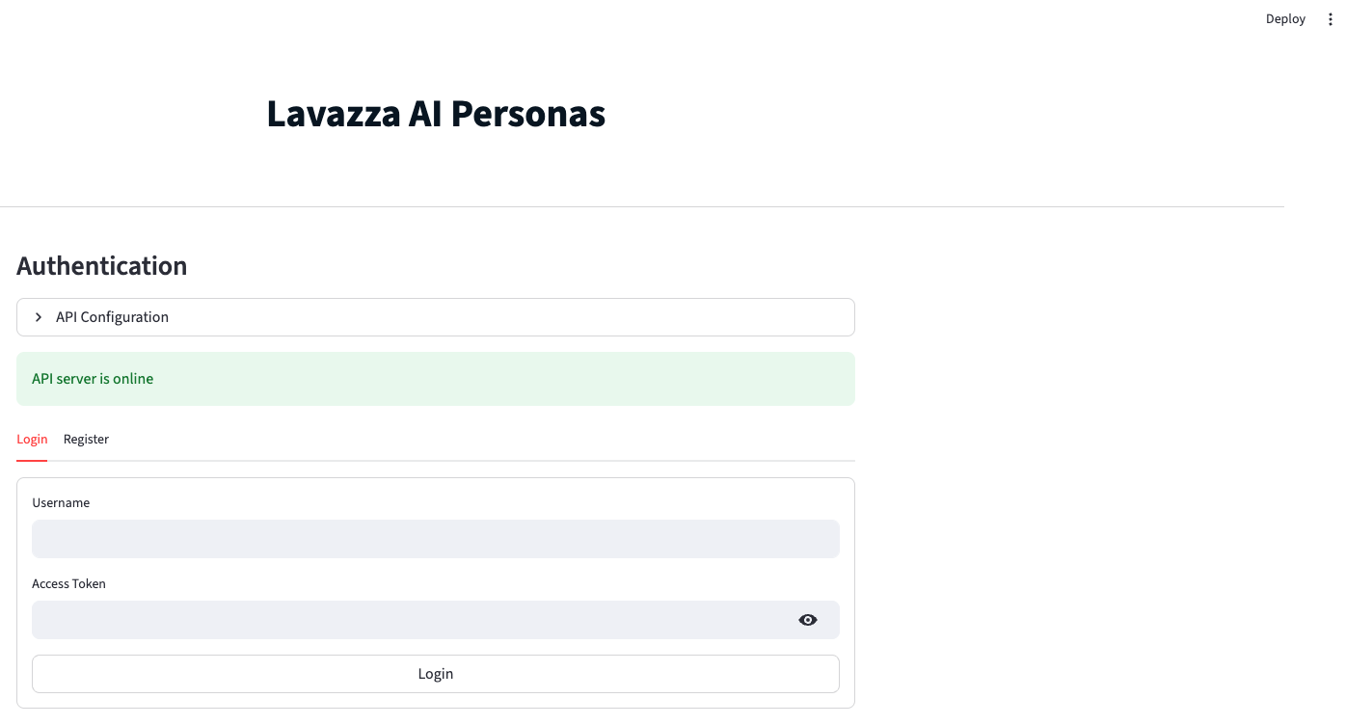
UI - Login

Slide 18
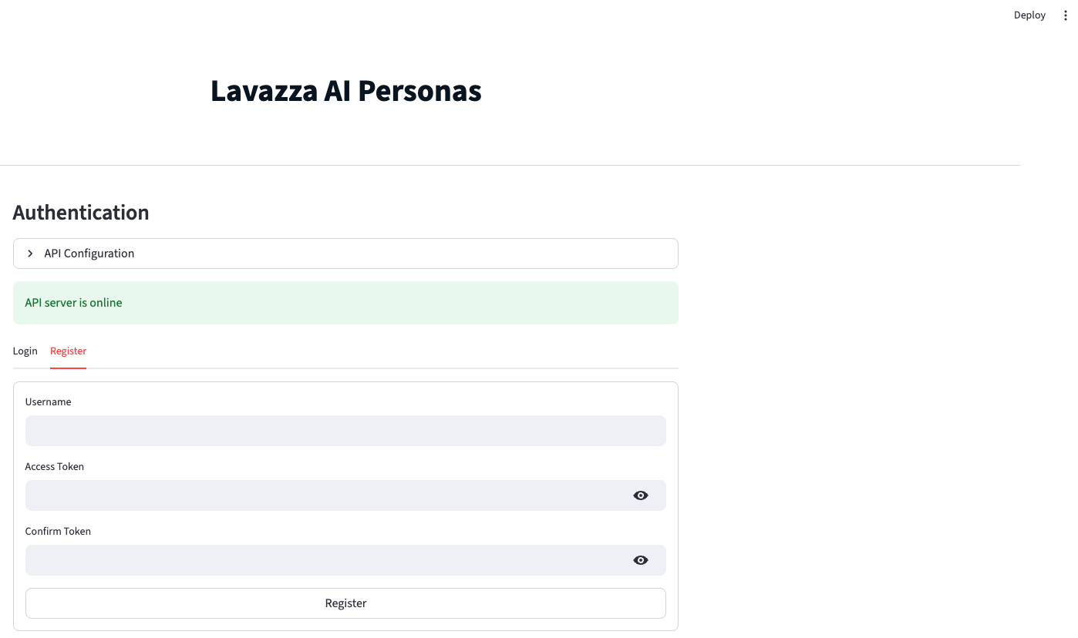
UI - Registration

Slide 19
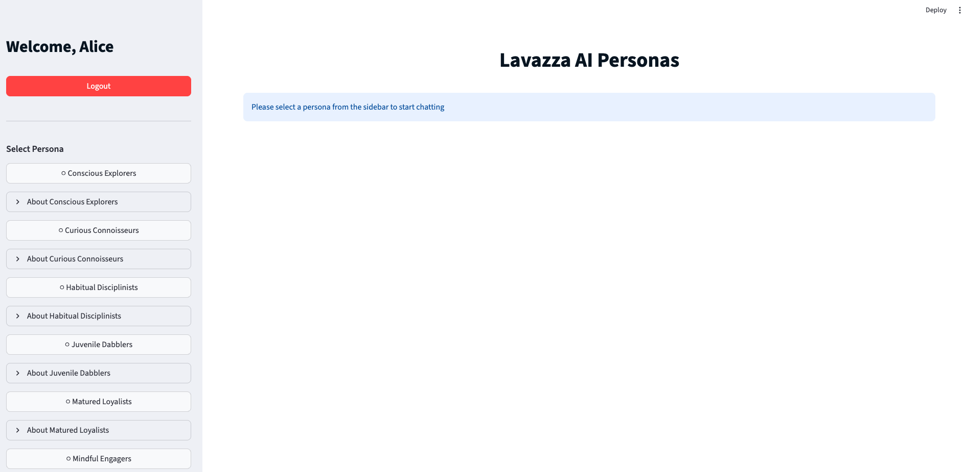
UI - Homepage

Slide 20
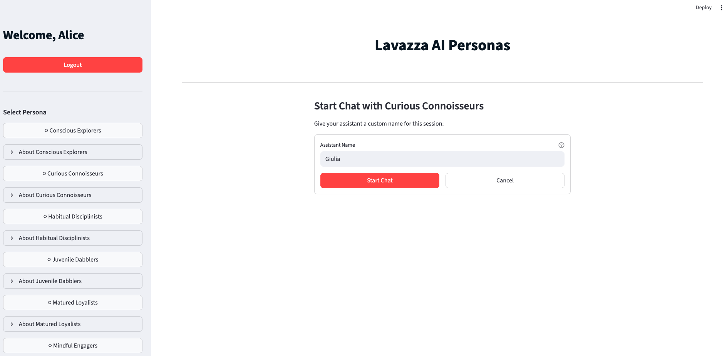
UI - Persona name customization

Slide 21
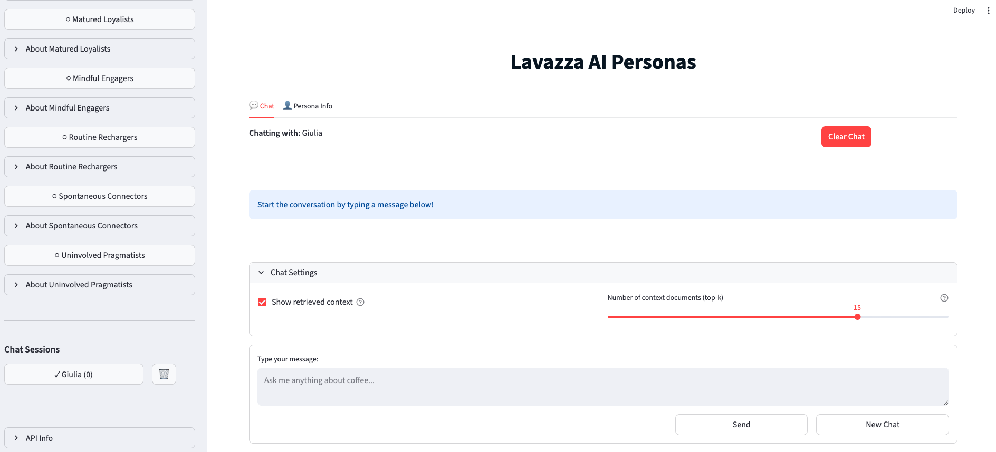
UI - Chat Management

Slide 22
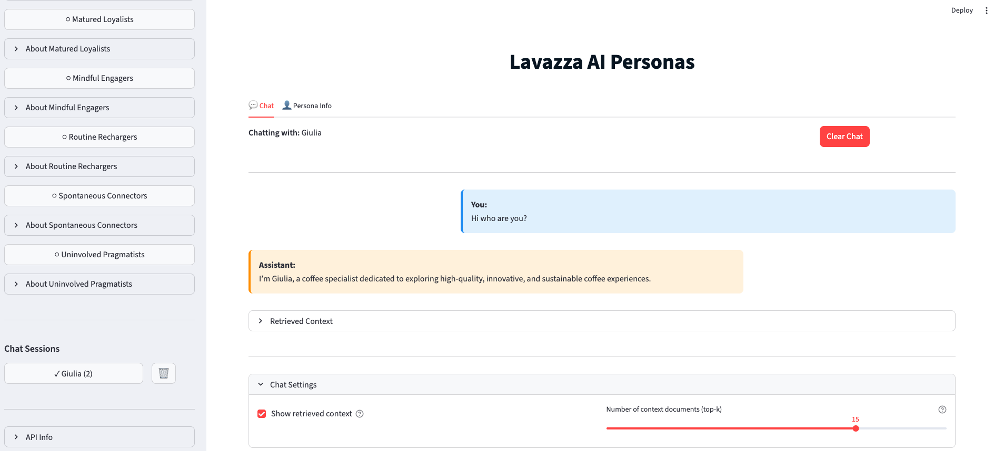
UI - Chat Interaction

Slide 23

Evaluation
Persona Extraction
Is persona information correctly extracted?
Fact Extraction
Is extracted fact data correct?
Retrieval Relevance
Is the retrieved information relevant?
Authenticity Evaluation
Do personas reflect real consumer segments?
Notes:
evaluation methodologies for four critical components of the Lavazza AI Personas system 1.Persona Extraction Pipeline - Validates extraction of persona indicators/metrics from PDF documents
2.Fact Extraction Accuracy - Ensures fact data is correctly extracted
3.Retrieval Relevance - Measures RAG system's ability to retrieve relevant context
4.Authenticity Evaluation - Confirms AI personas authentically represent consumer segments

Slide 24

Evaluation - Persona Extraction
Approach
Compare persona extraction outputs with manually annotated ground truth.
Metrics
Persona Detection Rate Are all target personas identified?
Metrics Recall Is the required information complete?
Metrics Precision Is the extracted information accurate?
*Persona Detection Rate = (Correctly Detected Personas) / (Total Ground Truth Personas)
*Metrics Recall = (Correct Metrics) / (Total Ground Truth Metrics)
*Metrics Precision = (Correct Metrics) / (All Extracted Metrics)

Slide 25
Evaluation - Persona Extraction
Configuration
Models:
Indicators extractor: mistralai/mistral-medium-3-instruct (Temperature = 0)
Persona traits reasoning: mistralai/mistral-medium-3-instruct (Temperature = 0)
Test dataset:
Scope: 23 pages focused on the Curious Connoisseurs segment
Ground Truth: 1,051 metrics manually extracted and validated from the PDF
Result
Score
Interpretation
Persona Detection Rate
100%
All personas correctly identified (23/23)
Metrics Recall
95.30%
Very high coverage of ground-truth metrics (1002/1051)
Minimal noise in extracted metrics (1002/1035)
Metrics Precision
96.80%
Notes:
Mistral Medium 3 model has not been publicly disclosed by Mistral AI.
Total 23 pages
Ground-truth personas
23
Detected personas
23
Ground-truth metrics
1,051
System-extracted metrics
1,035
Correctly matched metrics
1,002
Missed ground-truth metrics
49
Incorrect system metrics (noise)
33

Slide 26
Evaluation - Fact Extraction
Approach
Manually verify numeric and factual data against source PDFs.
Run extraction and check exact matches.
A result is correct only if ≥80% textual overlap with the extracted markdown.
Metrics
Exact Match Accuracy what fraction of expected facts were extracted correctly?
*Exact Match Accuracy = (Exactly Matching Values) / (Total Ground Truth Values)

Slide 27
Evaluation - Fact Extraction
Configuration
Models:
PDF to Markdown Conversion: mistralai/mistral-large-3-675b-instruct-2512 (Temperature = 0)
Test dataset:
Scope: 23 pages focused on the Curious Connoisseurs segment
Ground Truth: 467 validated metric and statement snippets manually extracted from the PDF
Result
Score
Interpretation
Exact Match Accuracy
97%
High extraction accuracy with minimal deviation from ground truth
Notes:
Mistral Medium 3 model has not been publicly disclosed by Mistral AI.
Total 23 pages
Ground-truth personas
23
Detected personas
23
Ground-truth metrics
1,051
System-extracted metrics
1,035
Correctly matched metrics
1,002
Missed ground-truth metrics
49
Incorrect system metrics (noise)
33

Slide 28
Evaluation - Retrieval Relevance
Approach
Create persona-specific test queries.
Retrieve top-K documents (K = 3, 5, 10, 20).
Manually label relevance for retrieval documents.
Metrics
Precision@K How many of the top K results are actually correct.
Recall@K How many of the total correct results were successfully found within the top K.
*Precision@K = (Relevant docs in top-K) / K
*Recall@K = (Relevant docs in top-K) / (Total relevant docs)

Slide 29
Evaluation - Retrieval Relevance
Configuration
Models:
Embedding: sentence-transformers/all-mpnet-base-v2
RAG setup:
Chunk Size: 1,200 characters
Chunk Overlap: 50 characters
Input: 222-page split to 712 total text chunks
Test dataset:
Ground Truth: 31 evaluation questions (e.g. “What are your preferred brands?”, …) focused on the Curious Connoisseurs segment
Top-25 retrieval per query; relevant documents manually labeled
Score
Interpretation
Minimal noise at the top
Precision@3
89.25%
Precision@5
88.39%
Still high quality
Precision@10
86.13%
relevance remains dominant
Precision@20
82.58%
Precision stabilizes at broader window
Recall@3
14.87%
Very limited early coverage
Recall@5
23.35%
Most relevant docs missed early.
Recall@10
45.98%
Roughly half captured in top 10.
Optimal performance occurs at k=20, supplying sufficient context for complete responses.
Most relevant documents recovered.
Recall@20
82.08%
Result
Notes:
Mistral Medium 3 model has not been publicly disclosed by Mistral AI.
Total 23 pages
Ground-truth personas
23
Detected personas
23
Ground-truth metrics
1,051
System-extracted metrics
1,035
Correctly matched metrics
1,002
Missed ground-truth metrics
49
Incorrect system metrics (noise)
33

Slide 30
Evaluation - Persona Authenticity
Approach
Generate persona-based responses to predefined questions.
Have domain experts score them on authenticity, style alignment, and factual grounding, each on a 1–5 scale.
Metrics
Expert Authenticity Score Average authenticity ratings.
Style Alignment Score Average all style alignment ratings.
Factual Grounding Score Average all factual grounding ratings.

Slide 31
Evaluation - Authenticity Results
Configuration
Models:
Filter context model: mistralai/mistral-small-24b-instruct (Temperature = 0)
Generation model: mistralai/mistral-small-24b-instruct (Temperature = 0.2)
RAG Setup:
Chunk Size: 1,200 characters (~300–350 tokens)
Chunk Overlap: 50 characters (to preserve context continuity)
Input: 222-page to 712 total text chunks
Test dataset:
Ground Truth: 31 evaluation questions focused on the Curious Connoisseurs segment
Result
Score
Interpretation
Expert Authenticity Score
4.66/5
Persona behavior is largely authentic.
Style is mostly consistent, with minor
persona drift.
Style Alignment Score
4.74/5
Factual Grounding Score
4.44/5
Responses are well grounded.
Notes:
Mistral Medium 3 model has not been publicly disclosed by Mistral AI.
Total 23 pages
Ground-truth personas
23
Detected personas
23
Ground-truth metrics
1,051
System-extracted metrics
1,035
Correctly matched metrics
1,002
Missed ground-truth metrics
49
Incorrect system metrics (noise)
33

Slide 32



Manage
Enrico
System design
Semantic fact extraction
Fact ingestion & indexing
RAG retrieval logic
Frontend development
Monitoring & evaluation
Communication & demo
Thanh
Project conception & initiation
Data foundation
Core layer
Persona semantic extraction
AI persona prompt tuning
Backend development
Evaluation: persona and fact data extraction
Xiaoning
Management
Application layer design
AI persona common trait extraction
Persona inference & serving
Evaluation dataset construction
Evaluation: Retrieval performance and persona authenticity analysis
Quality assessment

Slide 33

Enrico Chen - s337750
Van Thanh Nguyen - s336748
Xiaoning Ma - s337332

Slide 34

Appendix

Slide 35
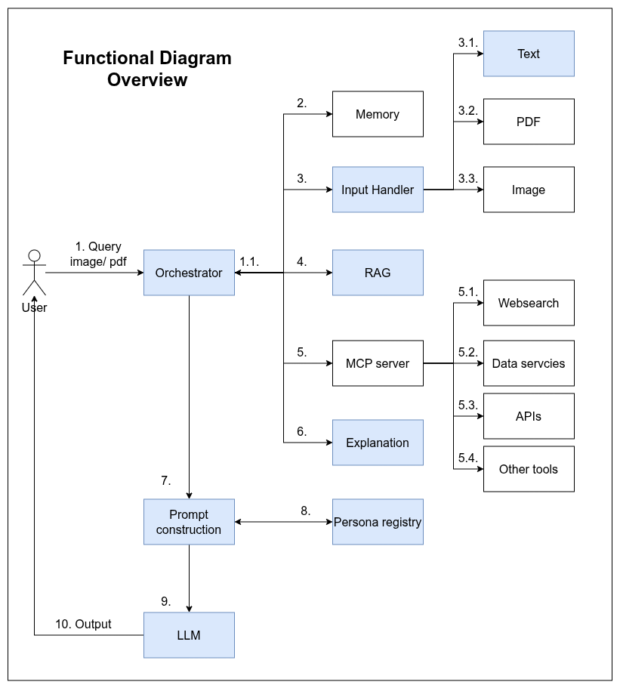
Design
1. User Query Submission: User sends a query with optional attached files (image, PDF, etc.) to the Orchestrator.
1.1 Orchestrator Analysis: The Orchestrator analyzes the query and attachments to decide which services should be used.
2. Memory Integration :Extract useful information from chat history.
3. Input Preprocessing: Inputs are preprocessed before passing to the model.
3.1 Text Input: Normalize text to make it easier to handle in later steps.
3.2 PDF Input: Parse, process, and extract meaningful information from PDF files.
3.3 Image Input: Process images and extract valuable information.
4. Context Retrieval (RAG System): Use the query and relevant input information to retrieve context (e.g., market data) via a RAG system.
5. Tool Selection & MCP Server Requests
Decide which tools should be used to enrich the context.
Send requests to the MCP server to gather corresponding context.
5.1 Web Search: Extract updated information from the internet (trends, real-time data, missing internal data, etc.).
5.2 Database Query: Retrieve useful data from internal or external databases.
5.3 External APIs: Call APIs to obtain additional information.
5.4 Other Tools: Use calculators, simulators, weather data extractors, or other utilities to enrich context.
6. Explanation: The explanation module will explain in detail the thought process of the reasoning model and the data used for the thinking process (citations from RAG).
7. Prompt Construction: The Orchestrator aggregates useful context and passes it to Prompt Construction.
8. Persona Selection :Apply the selected Persona profile, including: Demographics, Behavior Data, Transactional Data, …
9. LLM : Route to a particular LLM model, passing the enriched prompt and context.
10. Model Response: Generate a response with: Specific personality,Tone, Linguistic style of the Persona

Slide 36
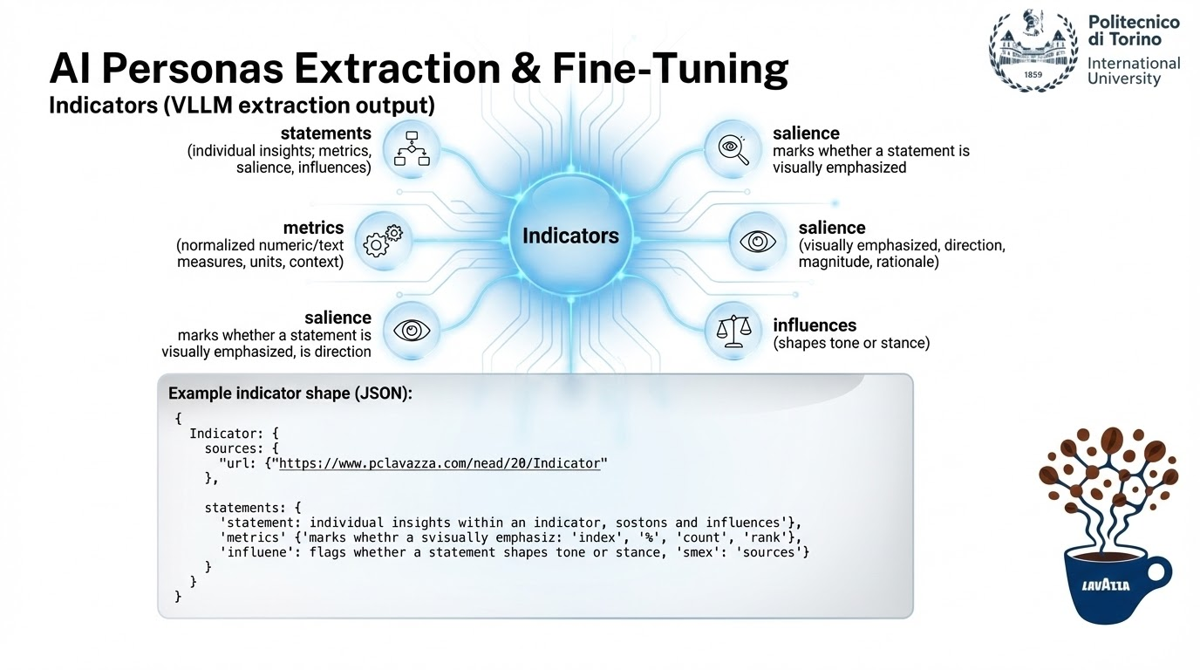

Slide 37
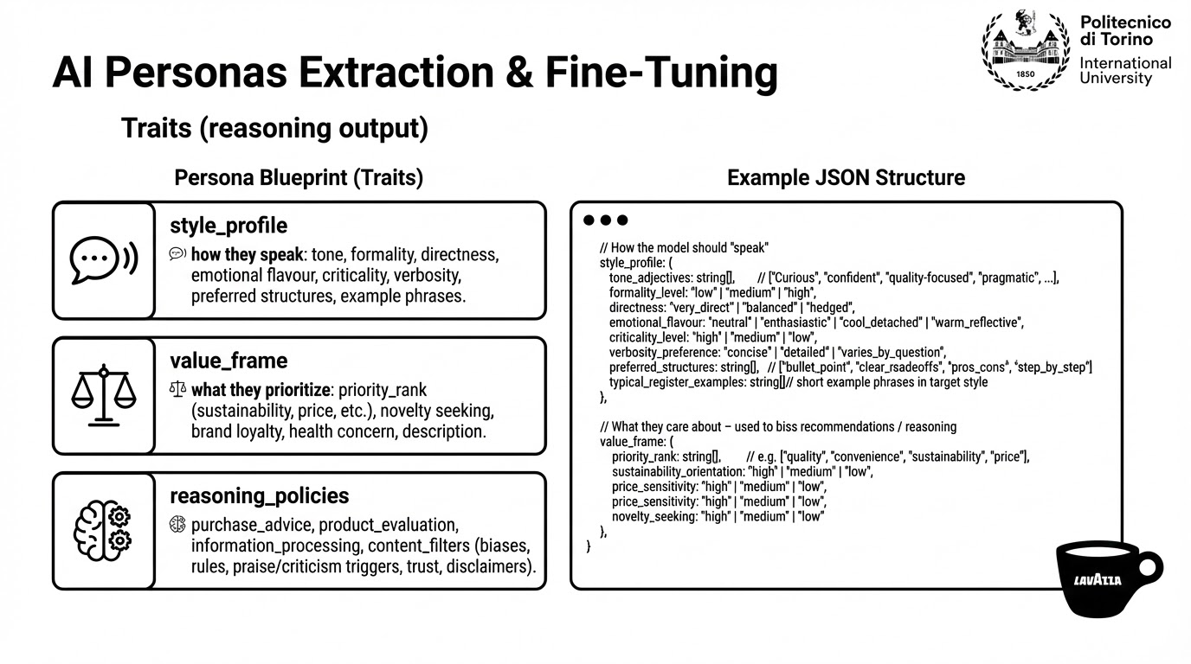


Slide 38
Design - Risks Analysis
Technical Risks
Hallucinations and inaccurate responses: mitigate with RAG system
Insufficient critical thinking: mitigate with RAG and prompt engineering
Opacity: mitigate with RAG
Inconsistent or generic personality: mitigate by fine-tuning (in case of limited resource use PEFT, smaller models, RAG with few-shot prompting)
Performance evaluation difficulty

Slide 39
Design - Risks Analysis
Governance and Security Risks
Privacy and compliance with AI Act and GDPR
Proprietary data protection
System integration difficulty with existing systems and infrastructure
Notes:
Privacy and Complience: complice AI acts and GDPR.
Proprietary Data Protection: Safeguard Lavazza’s business data, maintaining strict confidentiality and preventing unauthorized access.
System Integration: Ensure smooth and secure alignment of AI solutions with Lavazza’s existing company systems and infrastructure.

Slide 40
Design - Risks Analysis
Data and Other Risks
Data integration difficulty
Data quality and bias
Over relying on AI Personas
Notes:
2. Data Risks
Data Integration Challenge: Heterogeneous (e.g., PDFs, tabular data, …)
Quality and Bias Issues: Data may be qualitative, incomplete, or imbalanced across segments, leading to biased persona representations and limited generalizability.

